Slide 1
Story of a man with an unusual gastric mass
Presenter: Rohan Yewale, DNB MGE Registrar, SIMS Hospital, Chennai
Guide : Dr. B.S. Ramakrishna

Slide 2
Case capsule
43 year old gentleman seen by our department in August 2018
Presented with complaints of – “chronic indigestion”
Poor appetite
Early satiety x 1 year
Post prandial, vague, upper abdominal discomfort
Vomiting few hours after meals – non bilious, undigested food particles
Acute onset pain in left lower abdomen, radiating to
back with multiple episodes of non bilious vomiting x 3 days
No h/o weight loss, hematemesis, melena, hematochezia, jaundice, heartburn, dysphagia, bloating, altered bowel habits, hematuria, fever
H/o NSAID use on and off for abdominal pain

Slide 3
Past history
Diabetic, hypertensive since 3 years on regular medication
H/o multiple hospitalizations under various departments since the last 1 year
Denied any form of addictions
No significant family history

Slide 4
Timeline
July 2017
First evaluated for dyspepsia 1 year back
October 2017
Episode of acute gastroenteritis after 2 months
April 2018
Acute onset fever, cough, hemoptysis, dyspnea x 3d
February 2018
UGI – Upper esophageal submucosal mass
Left alone
Hospitalized for 3 days and treated symptomatically
Acute onset pain in right lower abdomen, vomiting, RIF tenderness – diagnosed as acute appendicitis on CT
Underwent Lap appendicectomy (Inflamed appendix in retrocecal position)
Diagnosed as CAP
EUS - mass arising from muscular layer (FNAB -Leiomyoma)
Treated with PTZ/AZE
CT chest – B/L lower lobe infiltrates, basal atelectasis and parapneumonic effusion

Slide 5
Examination
Well built
Overweight, BMI 30 kg/m2
Vitals normal
Per abdomen - soft, mild left lumbar tenderness +
Other systems normal

Slide 6
Investigations
Lab investigations – e/o acute kidney injury with elevated serum creatinine (1.94), urea (55) and raised Total WBC count (14,500)
Urine routine analysis normal, no growth on culture
Other baseline investigations essentially normal
CT abdomen – bilateral bulky kidneys with left perinephric inflammatory changes and a microlith in left kidney, no obstructive changes
Focal, heterogeneously enhancing wall thickening with ulceration and calcification in the posterior wall of antrum of stomach along the lesser curvature – incidental finding
Imp: Gastric ulcer and antral submucosal lesion ? Fibro-inflammatory lesion
Left Pyelonephritis

Slide 7
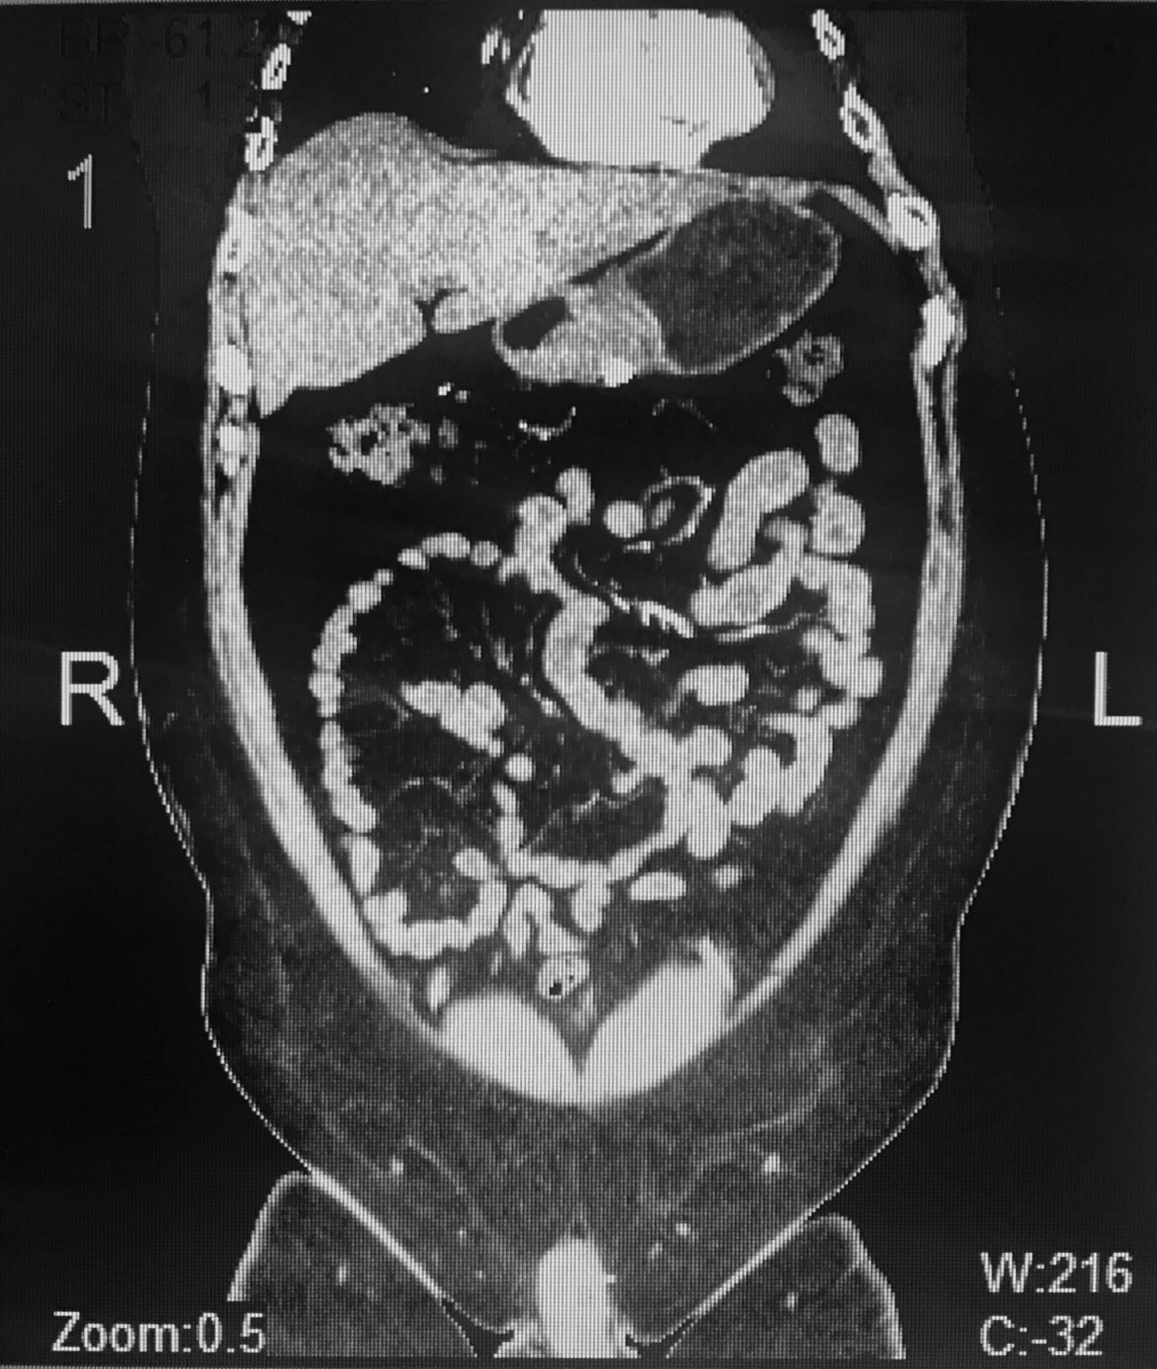

Slide 8
Treated symptomatically with iv fluids, antibiotics
AKI (? pre-renal azotemia / ? NSAID induced tubulo-interstitial nephritis / ? Acute pyelonephritis) settled
He was then evaluated for the incidentally detected gastric antral submucosal lesion

Slide 9
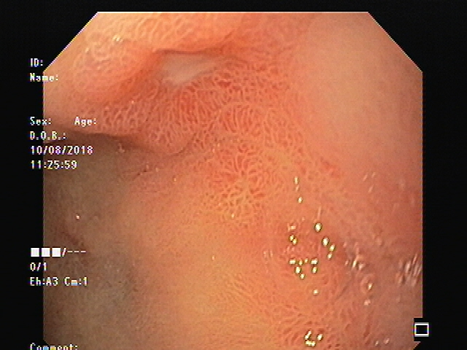
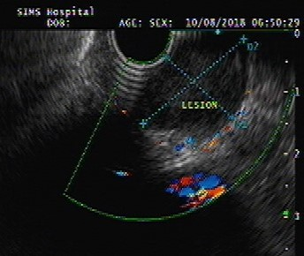
Upper GI endoscopy -
Antral submucosal lesion along the lesser
curvature with central excavated ulcer
Endoscopic biopsy - HPE
Mild chronic gastritis with focal active
inflammation and ulceration
Endoscopic Ultrasound
Submucosal mass lesion in antrum arising
from the muscular layer (layer 2), FNAB –
insufficienct tissue
Provisional diagnosis
Gastric antral submucosal mass lesion
Etiology …….. ?????

Slide 10
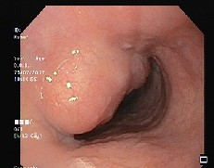

Slide 11
Surgical gastroenterology opinion sought
In view of ? GIST like appearance of the lesion without any evidence of other intra abdominal lesions on CT, laparotomy converted to open “partial gastrectomy/mass resection” was done
Operative findings –
7 x 5 cm mass in the greater curvature extending over posterior wall up to lesser curvature
Mass adherent posteriorly to the mesocolon
Showed symptomatic improvement and was discharged

Slide 12
Histopathology / IHC
Fibroinflammatory lesion with diffuse lymphoplasmacytic infiltrate
On the basis of histology, a diagnosis of IgG4 related disease was suggested
IHC - positive for IgG4 (35-40%)
Serum IgG 4 levels markedly elevated (4.36g/l; n-0.03-2.01)

Slide 14
Course after discharge
4 months later - October 2018
Readmitted with c/o –
Epigastric pain, continuous, unrelated to meals,
dull aching type, non radiating x 7 days
A/w occasional episodes of non bilious vomiting
Weight loss of 12kg x 3 months
No h/o back pain, GI bleeding, jaundice, altered bowel habits
Per abdomen soft, non tender, no guarding or rigidity
Baseline labs, amylase, lipase normal

Slide 15
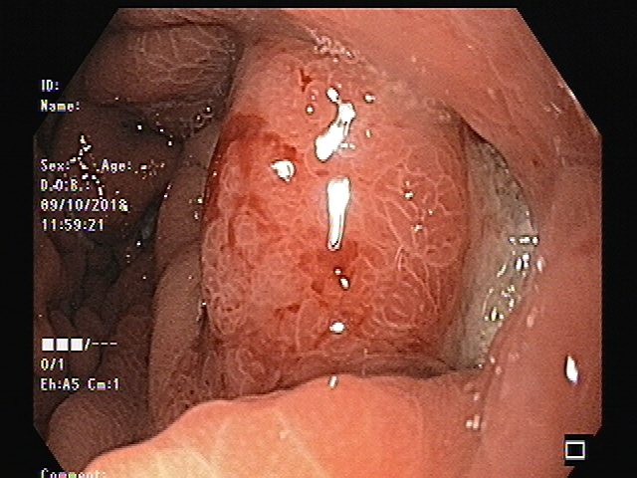
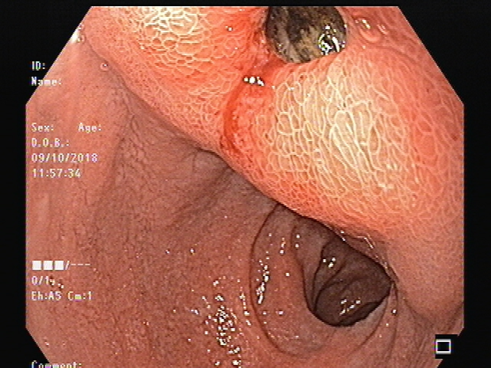
Upper GI endoscopy – submucosal lesion
esophagus (previous HPE - leiomyoma),
post - operative stomach with a linear gastric ulcer
at the site of resection and a deep excavating ulcer
in duodenum
Started on iv pantoprazole infusion with syrup
sucralfate
Thought to be a recurrence of IgG4 – RD,
hence started on
Inj hydrocortisone 100mg q8h for 3 days and later
changed to a tapering dose of T. Prednisolone
T. Azathioprine 50mg
Symptoms settled over the next few weeks

Slide 16
Epidural analgesia with bupivacaine
Erector spinae block
iv tramadol, fentanyl, oral opioids, Pregabalin
Radiofrequency ablation of DRG with celiac plexus block
2 months later - December 2018
Readmitted with similar complaints
(on Prednisolone 30mg and Azathioprine 50mg)
Upper GI endoscopy – Excavating clean based
ulcer in antrum parallel to resection site
and a clean based duodenal ulcer
HPE – Marked reduction in plasma cell
infiltration in gastric mucosa, H. Pylori +
Serum IgG 4 levels reduced (2.71 g/l)
Oral steroids, Azathioprine continued
Pain management

Slide 17
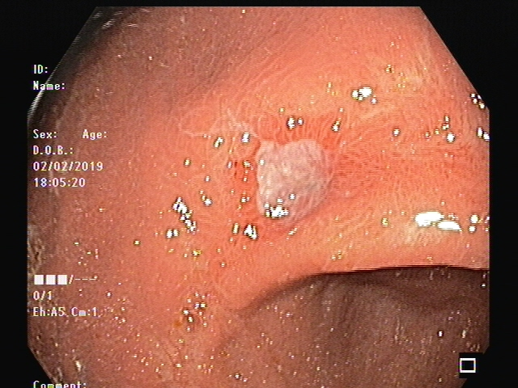
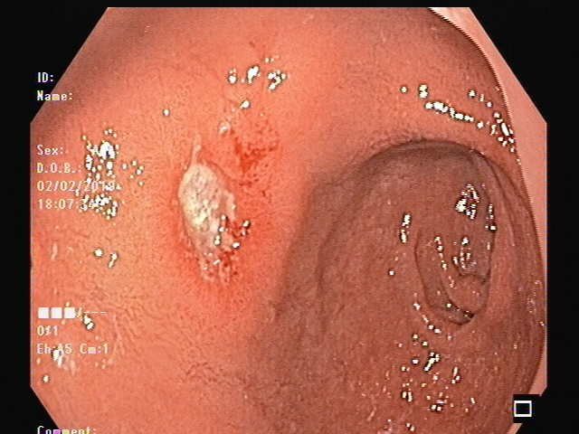
Readmitted after 1 month - Feb 2019
Persistent epigastric, left upper quadrant pain,
occasional vomiting
Upper GI endoscopy – partially healed
residual gastric ulcer, healing duodenal ulcer
HPE - Very few plasma cells
IHC – IgG4 10 cells/HPF (1+)
Diagnostic dilemma
Was IgG 4 – RD in remission ?
If not, should Rituximab be considered ?
Were we missing out on some other condition ?

Slide 18
CT abdomen with oral contrast – retention of contrast material in stomach – severe gastroparesis, gastric outlet obstruction
Gastric scintigraphy – Delayed gastric emptying
Diagnosis – Post operative gastroparesis
Underwent gastric antral resection with truncal vagotomy and gastrojejunostomy
Last follow up in April 2019 – asymptomatic, regained appetite and weight

Slide 19
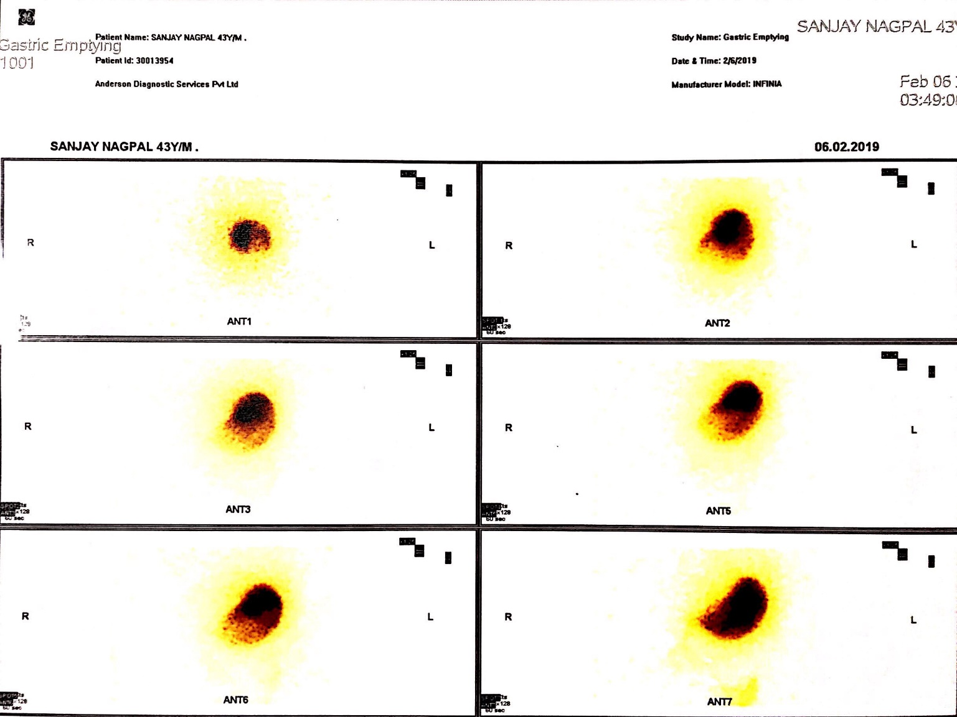

Slide 21
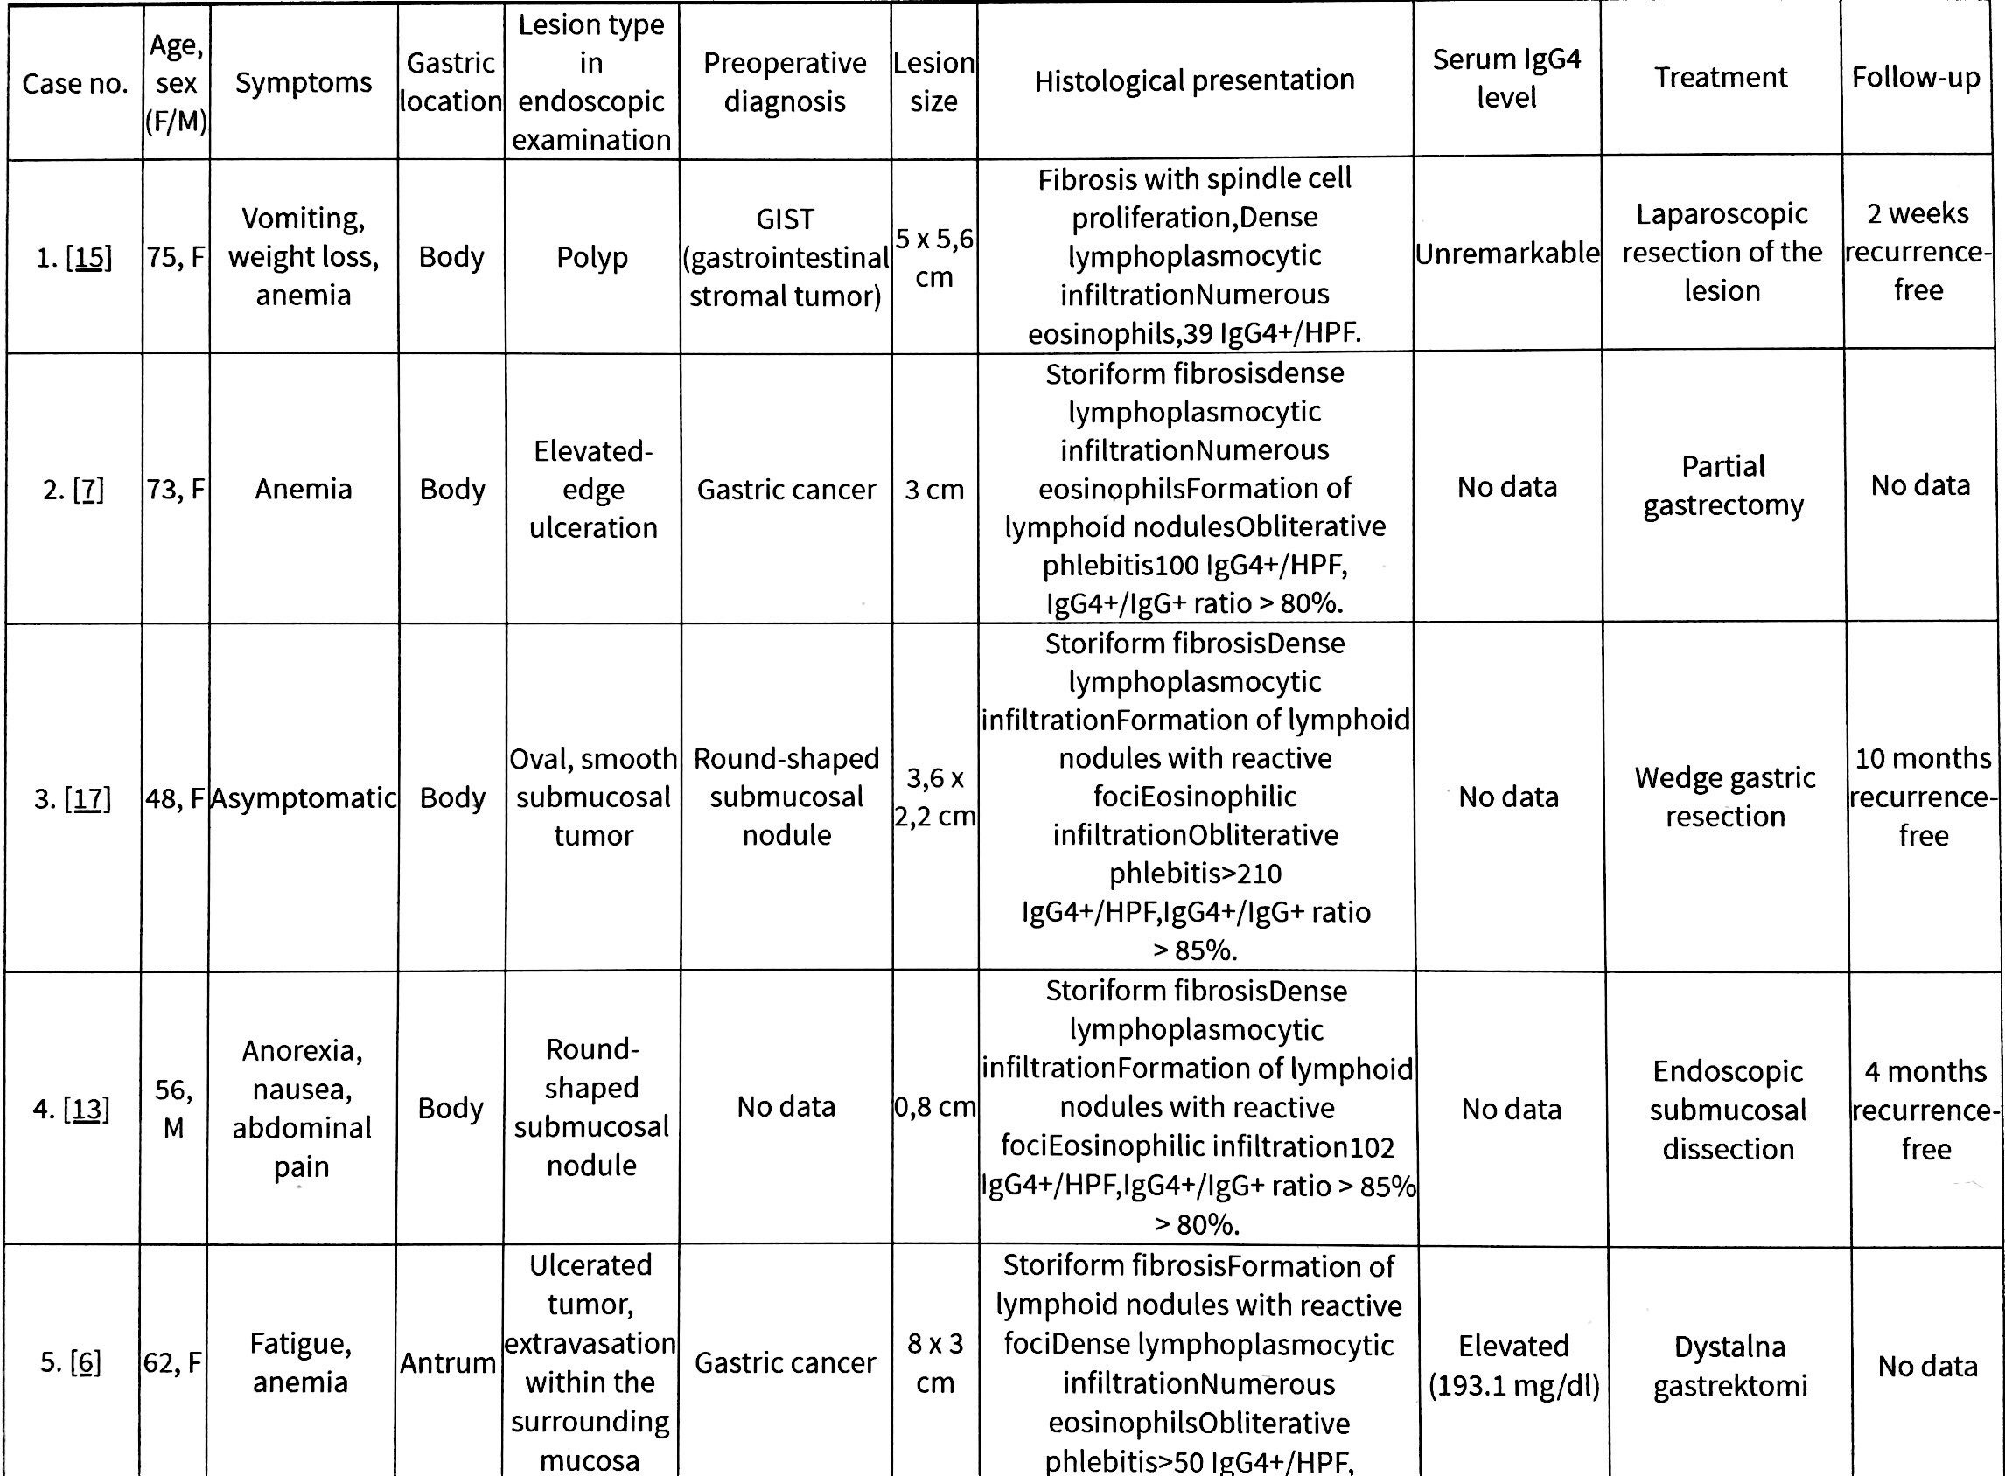
IgG-4 RD presenting as isolated gastric lesions – A literature review
Skorus. U et al; Pol Przegl Chir; Jun 2018

Slide 22
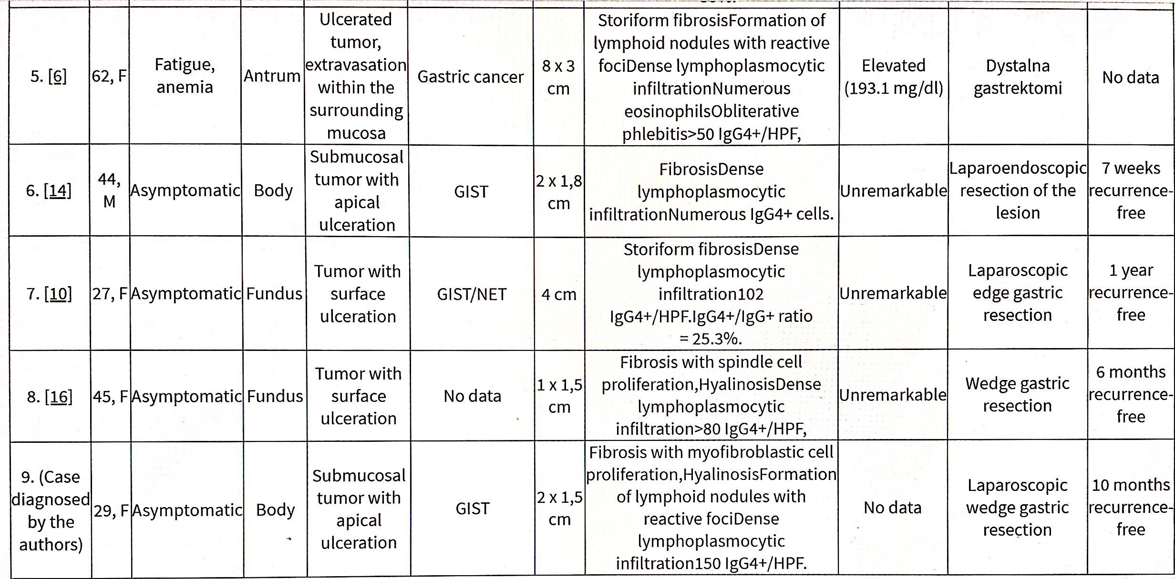

Slide 23
Our experience so far…
Case No | Age/Sex | Symptoms | Gastric location | Lesion type in endoscopic examination | Pre-operative diagnosis | Lesion size | HPE/IHC | Serum IgG4 level | Treatment | Follow up
1. | 43/M | Dyspepsia vomiting, Poor appetite, Recurrent admissions for multi system illnesses | Antrum | Submucosal lesion with a central excavated ulcer | GIST / Malignancy | 7 x 5 cm | Dense lymphoplasmacytic infiltrate, IHC – Positive for IgG 4 cells (35-40%) | 4.36g/l elevated | Surgical resection f/b Tapering steroids and IM | Stormy course, Gastric ulcer, Post operative gastroparesis No recurrence at 11 months
2. | 58/M | Epigastric fullness, heartburn | Distal body along lesser curve | Submucosal lesion | GIST | 4 x 4.5 cm | Lymphoplasmacytic infiltrate, storeiform fibrosis |  | Lap wedge resection | No recurrence at 6 months

Slide 24
Take home message
Over the last 6 months, we have come across 2 cases of gastric submucosal lesions which on surgical resection turned to be IgG 4 - RD on HPE and IHC
Thus, although IgG4-RD itself is a rare entity, mainly presenting as autoimmune pancreatitis, it can also present as gastrointestinal submucosal mass lesions
When a patient has a history of multisystem involvement of doubtful etiology dispersed in time, IgG4 – RD should be considered as a differential diagnosis
Surgery may not be the final cure since it is a multisystem disease with relapses and remissions
Monitoring disease remission remains to be a challenge

Slide 25
What is IgG4 - RD
Chronic,
Relapsing,
Multi-organ,
Fibro-inflammatory syndrome
Of presumed autoimmune etiology
Characterized by increased serum levels of IgG4 and tissue infiltration by IgG4+ cells

Slide 26
What makes it so unique ?
Pathognomonic antigens probably differ among different manifestations
Different antigens or autoantibodies produce
Similar immune reactions in different organs

Slide 27
Epidemiology
Estimated prevalence of fewer than 1 per 100,000 in the general population
largely a disease of men, with a 3:1 male predominance
Typically diagnosed late in life (mean age older than 60 years)
Commonly affected organs
Men – pancreatitis
Women – salivary glands

Slide 28
Pathogenesis
2 parallel immunologic processes
Tissue-destructive process mediated by activated
lymphocytes, macrophages and fibroblasts
Anti-inflammatory response that involves IgG4 and regulatory T (T reg) cells
Immunological triggers
Potential autoantigens – carbonic anhydrase, trypsinogens, annexins A11)
Chronic exposure – microbes, chemicals
Solvents, metal dusts

Slide 30
Organ involvement – multisystem
Gastro-intestinal
Extra - Gastrointestinal
Pancreas – autoimmune pancreatitits type I
Bile duct – sclerosing cholangitis
Retroperitoneum
Liver
Gall bladder
Small, large bowel
Stomach
Lacrimal glands
Salivary glands
Kidneys
Lungs
Orbit
Thyroid
Sinuses
>50% patients have more than 2 organs involved - Pooled analysis of 5 large studies in 758 patients

Slide 31
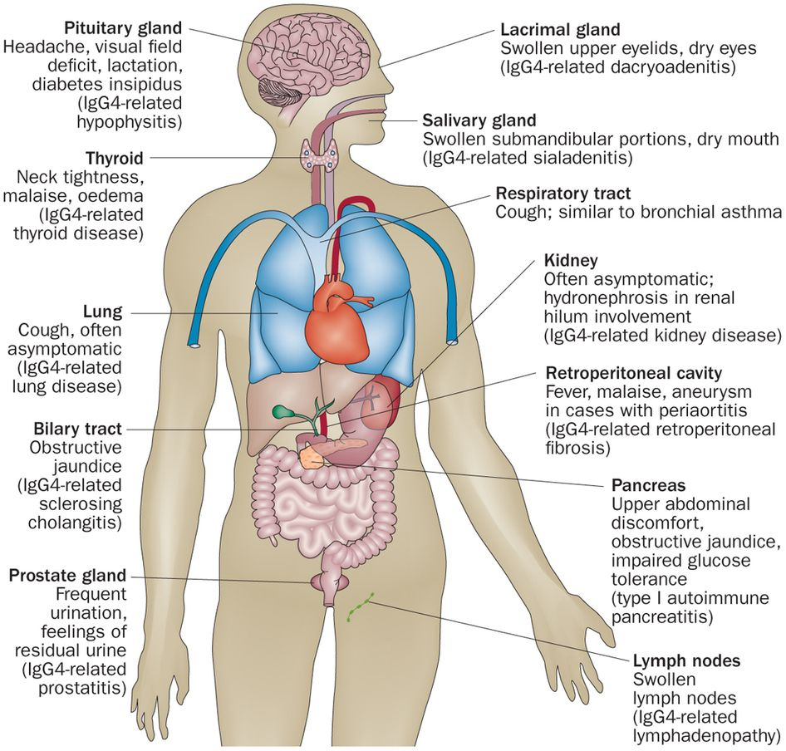

Slide 32
Modified HISORt criteria for diagnosis of IgG4-RD
HISORt | Domain | Features | Level 1 | Level 2 | Not suggestive
H | Histology and immuno-staining | Dense lymphoplasmacytic infiltrate, Storiform fibrosis, Obliterative venulitis, Abundant IgG4+ plasma cells, IgG4+/IgG+ plasma cells >40% | Any 4 of 5 | Any 2 of 5 | Involved organ shows any of: Scant IgG4+ plasma cells IgG4+/IgG+ plasma cells <40% Malignant cells Features of infection (neutrophils/ abscess/organisms)

Slide 33
HISORt | Domain | Features | Level 1 | Level 2 | Not suggestive
I | Imaging | Typical imaging features | Typical pancreas involvement Bilateral involvement of 2 sets of salivary/lacrimal glands | Renal lesions Bilateral involvement of a single salivary set of salivary / lacrimal gland Retroperitoneal fibrosis Lung lesions | Involved organ shows features suggestive of malignancy with workup for malignancy not done or inconclusive Long-bone abnormalities suggestive of Erdheim-Chester disease
S | Serology | Serum IgG4, autoantibodies, complement | Serum IgG4 levels >3 X ULN | >=1 of: Serum IgG4 levels 1–2 X ULN Low complement | Cryoglobulinemia Autoantibodies to Ro, La, double-stranded DNA, ribonucleoprotein, Smith, neutrophil cytoplasm (ANCA) Other disease-specific antibodies

Slide 34
HISORt | Domain | Features | Level 1 | Level 2 | Not suggestive
O | Organ | Typical organs involved: pancreas, bile duct, salivary glands, lacrimal glands, retroperitoneum, kidneys, lungs | >=2 organs involved | 1 organ involved | None of typical organs involved
Rt | Response to steroid therapy | Reduction/resolution of inflammatory component after 4 wk of treatment with at least 20 mg/d prednisone | Rapid response of inflammatory component | Partial response | No response to therapy

Slide 35
DIAGNOSTIC COMBINATIONS
Classic clinical profile | All 4: Imaging: Level 1 feature in >= 1 organ Organ involvement: level 1 feature Another domain: >1 level 1 or 2 features Remaining domains: no relevant not suggestive features
Diagnostic histology | Both: Histology/immunostaining: >=4 features Another domain: >= level 1 or 2 features
Response to steroids | All 3: Response to steroids: level 1 Other domains: level 1 or 2 in >= 3 domains No: not suggestive criteria
Organ specific diagnostic criteria | Meets international consensus diagnostic criteria for IgG4-related pancreatitis

Slide 36
TREATMENT
ALGORITHM
Meets diagnostic criteria for IgG4 RD
H/o or potential for steroid resistance / Multiorgan involvement / Proximal biliary disease
Yes
No
Prednisone 40 mg/day × 4 weeks, then taper by 5 mg/week
Reassess at 6-8 weeks
Incomplete response, requirement >20mg/d and/or steroid intolerance
Rapid, complete/near complete resolution
Alternative diagnosis
Start IM: Taper prednisone with ~8 weeks overlap
Taper prednisone without maintenance therapy
Switch IM
IM intolerance
Remission achieved
Unable to wean off prednisone
Continue IM × 12-18 months
2 doses
1000mg/dose
2 weeks apart
Consider increasing IM, if possible
Reassess every 3–6 months for relapse
Rituximab
Relapse (IM resistant AIP)

Slide 37
Thank You

